Slide 1
Mentoring and Collaboration
Heshani Pupulewatte, Haozhe Wang, Gayatri Ganeshan
16:160:603 Introduction to Research
November 10, 2021

Slide 2
Mentoring in graduate school
“A close, individualized relationship that develops over time between a graduate student and a faculty member, that includes both caring and guidance”
Johnston, J. (2010). Mentoring Graduate Students. Vanderbilt University Center for Teaching.
https://cft.vanderbilt.edu/guides-sub-pages/mentoring-graduate-students/

Slide 3

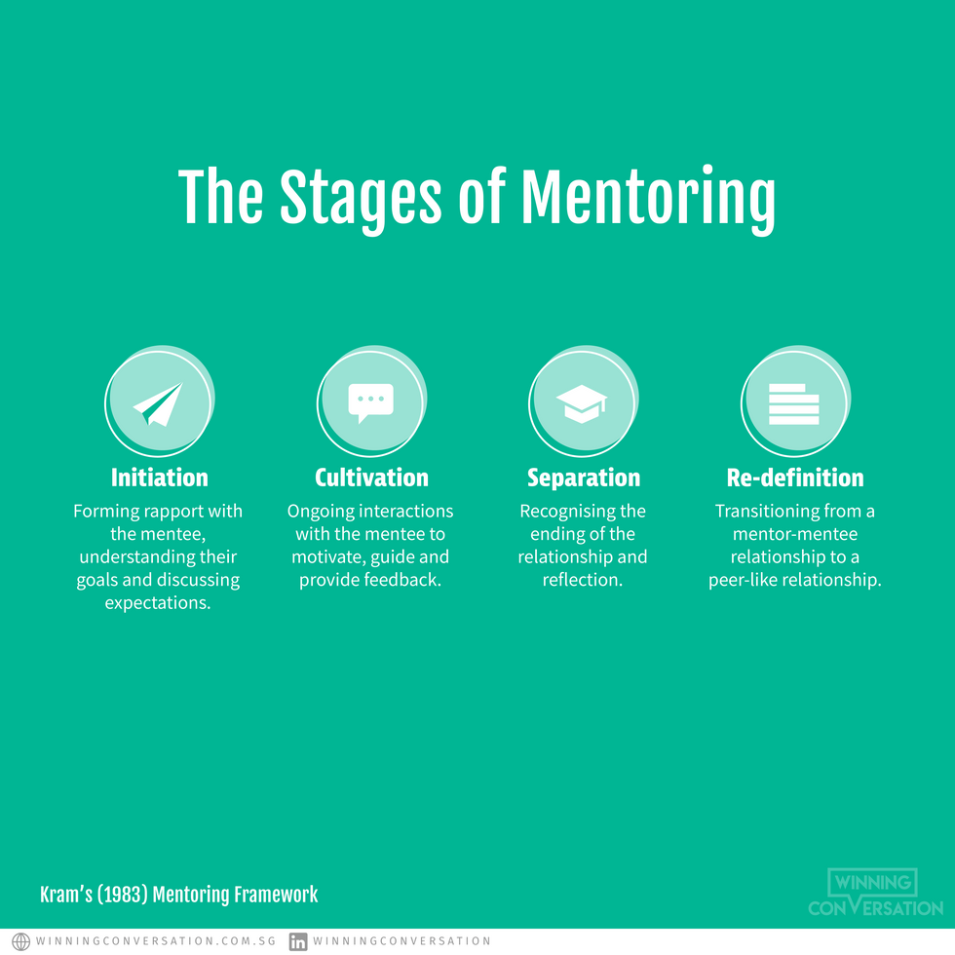




Stages of mentoring
Abbott-Anderson, K.; Gilmore-Bykovskyi, A.; Lyles, A. The Value Of Preparing Phd Students As Research Mentors: Application Of Kram's Temporal Mentoring Model. Journal of Professional Nursing 2016, 32 (6), 421-429.
Notes:
Initiation – forming rapport, understanding goals and discussing goals & expectations
Culti- ongoing interactions with the mentee to motivate, guide and provide feedback
Seperation – recognizing the end, reflection
Re-definition – trnasition from mentor-mentee to peer like relationship

Slide 4

Types of mentoring
Professors mentoring graduate/undergraduate students
Postdocs mentoring graduate/undergraduate students
Established professor mentoring junior faculty members

Slide 5
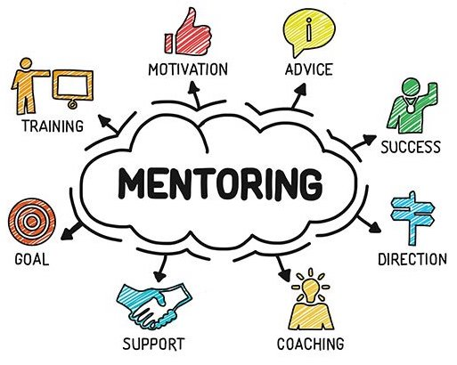
1. Professor mentoring graduate students
Four themes of mentoring relationships
Faculty as Advisor
Faculty as Instructor
Faculty as Employer
Faculty as Agent of Socialization
What mentoring does not involve
Setting goals for or managing the mentee’s career
Doing work for the mentee
Lechuga, V. Faculty-Graduate Student Mentoring Relationships: Mentors’ Perceived Roles And Responsibilities. High Educ 2011, 62, 757-771
Notes:
Advisor,speaks to issues regarding faculty mentors as a source of academic advice and personal support or counsel.
relates to an awareness to create formal or structured learning situations to help graduate students develop particular skills. The third theme,
,refers to a component of the F-GS relationship that resembles that of a supervisor and staff member. And the final theme,
reflects the notion of faculty members as a socializing group, assisting in the development of students’ professional skills and initiating them into the norms and values of their respective disciplines

Slide 6

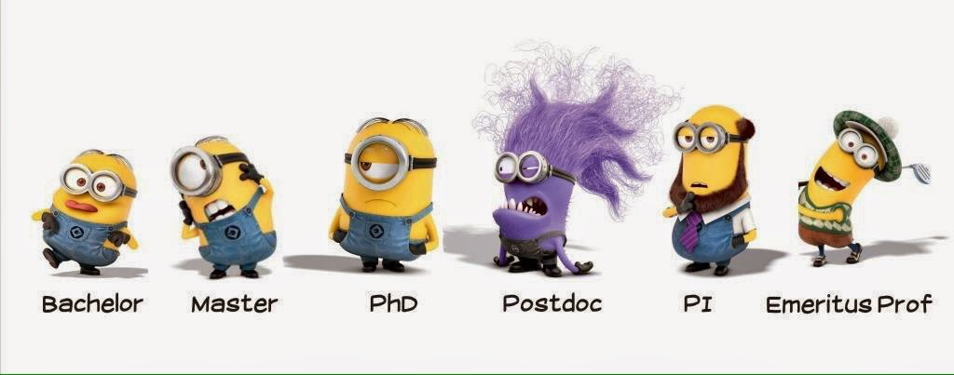
Mentoring may depend on,
Study field
Experience (Tenure vs Non-tenure)
Age
Gender
Ethnical/ cultural background
Student’s
Mentor’s
Student’s education Level
Pearson, M. & Brew, A. (2002). Research training and supervision development. Studies in Higher Education, 27(1), 135–150.
Notes:
Junior faculty….
ability to work autonomously
to have high computational and mathematical skills
and to take initiative.
Tenured faculty…
developing their graduate students’ abilities to present at national and international conferences
to network with senior faculty from other institutions and to learn how to create their own networks.

Slide 7


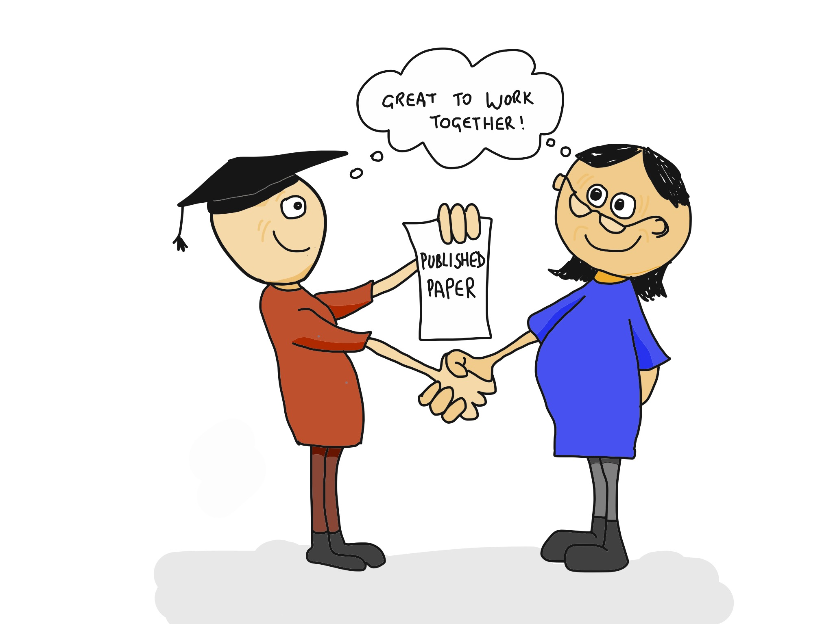
Best practices of mentoring
Communicate with students
Demystify graduate school
Provide constructive and supportive feedback
Provide encouragement
Treat students with respect
Provide a personal touch
https://www.mcgill.ca/gradsupervision/supervisors/roles-and-responsibilities/mentoring
Notes:
1. Engage with students in various ways from simple things such as saying hello to them in the hallway, asking them how they are doing in their courses, or inviting them for a cup of coffee when you are free of distractions.
Talk to your students on a regular basis.
Reach out to those who seem remote to see if that is simply their cultural way of being respectful or if it is due to their sense of social or academic isolation.
Let them know how and when to best reach you if they want to talk (i.e., e-mail, cell phone, or stopping in during office hours).
2. Many first-year students need help to get through the jargon that exists within the field, the department, and the Graduate College. Many are hearing terms such as “qualifying” exams or “orals” for the first time.
Make the implicit explicit. Clarify the vague or unwritten aspects of the program’s expectations for committees, courses, research, etc. Almost all students need help with the finer, often unstated, points of doing a thesis or dissertation.
At each stage of the graduate experience, explain the formal and informal criteria that the faculty use to determine what will count as quality work on the part of the student.
Alert students to pitfalls well ahead of time, notably those that may affect funding or graduate standing.
3. You should avoid assuming that students know what you think of their work.
Tempering criticism with praise when it is deserved will help remind students that your high standards are intended to help them improve.
Some mentors make the assumption that students who fall behind in their work lack commitment. Rather, they may be exhausted, unclear about what they need to do next, experiencing difficulties with resources, or running into problems with collaborators. An understanding of their perspective is a constructive approach.
4. Generally, students should take the risks of making the kinds of mistakes that often lead to better learning. You might even share with them a less than successful experience of your own, such as a heavily critiqued paper you wrote.
Encourage students to discuss their ideas with you or other colleagues, even the ideas that the student might think naïve.
Let those assigned to you for advising know clearly that changing advisors can and does happen. Students might be unaware of this possibility.
Reassure students of their skills and abilities. Many of them may be experiencing doubts and anxieties as to whether they belong in graduate school
5. Avoid allowing the phone or other visitors from distracting or interrupting you while you are meeting with one of your students. A common concern among graduate students is that they do not get their professors’ full attention. Focus on the student while you are with them.
Keep notes on discussions to review prior to your next meeting.
Faculty often can learn a lot from their students, but how often do they tell that to the students? Such disclosures give the students confidence.
Acknowledging the prior skills, experience, and knowledge that the students bring with them to graduate school helps to build their confidence.
6. Be open and approachable. When students need to talk to you about academic or non-academic issues, knowing that they can reach you is very helpful.
Help students find creative solutions to their academic or personal challenges.
Be familiar with campus resources so that you can refer students should the need arise.

Slide 8
2. Mentoring relationships between doctoral students and postdocs
Postdoc
Principal Investigator
Senior graduate student
Junior graduate student
Student
Undergraduate student
Blaney, J.; Kang, J.; Wofford, A.; Feldon, D. Mentoring Relationships Between Doctoral Students And Postdocs In The Lab Sciences. Studies in Graduate and Postdoctoral Education 2020, 11 (3), 263-279.

Slide 9

Postdocs mentoring graduate students
Viewed as informal advisors for graduate students
More regularly accessible & guide students through daily scientific tasks
How do postdocs engage in mentoring?
Hands on instruction in the lab
Academic feedback
Personal support
Career role modelling
Lab politics
Can negatively affect students too…
Observing postdoc mistreatment
Negative experiences
Blaney, J.; Kang, J.; Wofford, A.; Feldon, D. Mentoring Relationships Between Doctoral Students And Postdocs In The Lab Sciences. Studies in Graduate and Postdoctoral Education 2020, 11 (3), 263-279.

Slide 10
3. Established professor mentoring junior faculty members
Vary based on
department, field, career stage, research interests, teaching interests, and life experiences
Mentoring
Formal
Informal
https://facultyresources.fas.harvard.edu/files/facultyresources/files/mentoring_guide_to_departments_2016_04_21.pdf?m=1461335444

Slide 11
Assigned formal mentoring
Understand if
Understand if
Check -in
Mentee
has a proper
Network
Mentee
is performing effectively
Know
Mentee’s
Timeline
Listen
Discuss
Advice
Plan
Associate Review
Tenure Review
Individual Development
Multi Year
https://facultyresources.fas.harvard.edu/files/facultyresources/files/mentoring_guide_to_departments_2016_04_21.pdf?m=1461335444
Notes:
Listen, discuss, and give advice on research, teaching, and service.
Check in - at least once per semester.
Know your mentee’s timeline for associate review and tenure review
Multi-year plan/individual development plan
Understand if the mentee is sufficiently connected to a network of scholars in his/her field
Understand if the mentee is performing effectively

Slide 12
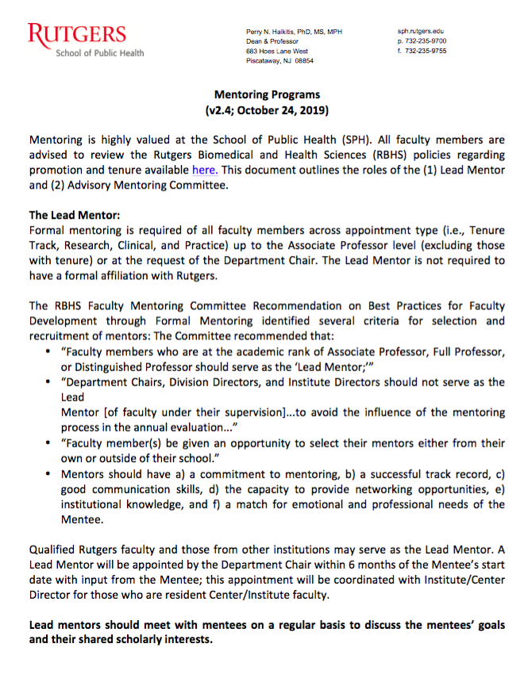
More formally,
Junior faculty members usually have an ‘Advisory mentoring committee’
In general, Department Chairs and direct supervisors (i.e., Center/Institute Directors) ‘should not’ serve on the Advisory Mentoring Committee of faculty in their Departments and/or Centers
‘Not within the purview’ of the Committee to ‘prescribe or recommend the faculty member’s workload distribution’
http://sph.rutgers.edu/faculty-staff/assets/docs/Faculty-Mentoring.pdf

Slide 13

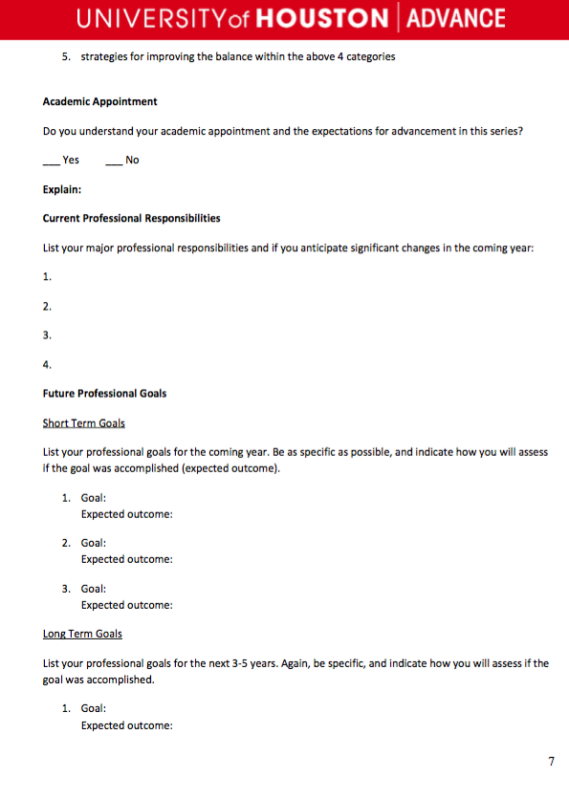
Best practices
Tenure-track faculty are their colleagues – not graduate students
Tenure-track faculty members prefer that the mentor take the ‘initiative to set up regular meetings’ and to ‘follow through’ on them.
Regular, informal, one-on-one meetings yield productive conversations with lasting impact
“open-door” policy
Mentors are rotated.
https://uh.edu/advance/resources/AssociateProfessor_FullProfessorMentoringGuidelines.pdf
Notes:
– and should be treated accordingly.

Slide 14
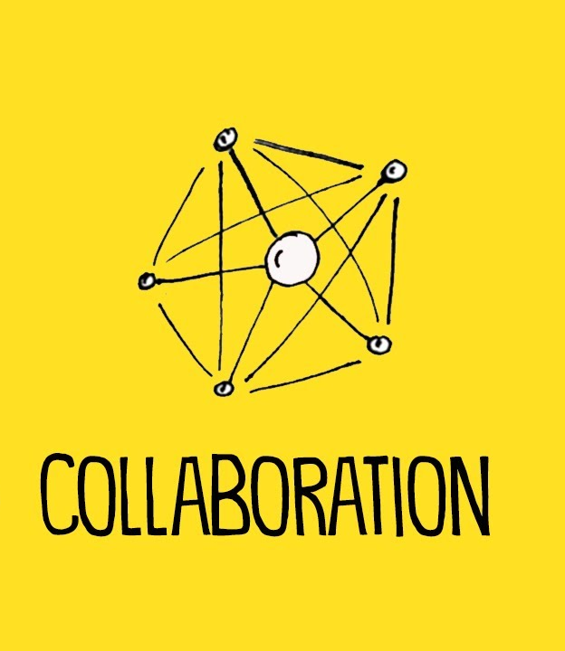
Academic Collaboration
“In this paper we argue that: (1) There is a useful analytical distinction to be made between collaboration (fluid and expressive) and Collaboration (concrete and instrumental); (2) These two are not mutually exclusive and their use varies between disciplines; and (3) This distinction is an informative one for policy making that aims to encourage collaboration.
collaboration
– whether formally or not
– discussion and exchange of ideas
Collaboration
– the formal kind of collaboration
– apply for grants together and coauthor papers
Lewis, J. M.; Ross, S.; Holden, T. High Educ. 2012, 64, 693–708

Slide 15

IdeaLab
https://npcc.no/2019/11/05/cities-for-the-future-services-and-solutions/

Slide 16
IdeaLab: Cross-disciplinary collaboration in Norway
Collaboration across diverse fields
…
Chemistry
Sociology
Physics
Architecture
a group of around 30 people work on designing viable projects around a theme, with the help of mentors and leaders
3 years of funding is divided among those projects which are most pertinent and viable
an open call for applications
https://www.ncn.gov.pl/en/eeanorwaygrants/calls/idealab

Slide 17

The 1st Norwegian IdeaLab
Complete the team
This meant advertising for, and hiring, postdoctoral and doctoral colleagues. This took time, and one of the projects kicked off with an incomplete team. In other projects, life circumstances changed so that some team members have changed job or taken long-term leave.
Keep in touch with the team
Meetings are most often virtual. Add to that the normal problems with getting a group of people together at any one time, plus illnesses, other meetings, holidays... It is a wonder that group members keep in touch with each other at all.
Work towards a common goal
Keep communication open
Translate results into clear language
https://www.jobs.ac.uk/media/pdf/careers/resources/making-academic-collaboration-work.pdf

Slide 18
How researchers think about collaboration?
91%
84%
79%
91% of researchers agreed that collaboration increases research impact
84% of researchers think that informal collaborations are as important to formal collaborations in their institution
79% of researchers said that collaboration makes them more productive
Survey provided by https://www.jobs.ac.uk/

Slide 19
What are the benefits?
Stimulation
of New
Interdisciplinary
Fields
New Applications
for Research
Methodologies
Increased Productivity
Opportunities
to Develop
Leadership
Skills
Opportunities
to Develop
Communication
Skills
Increased
Opportunities
for Meaningful
Impact
Access to
New Funding
Streams
https://www.jobs.ac.uk/

Slide 20
Tactics to avoid common pitfalls of collaboration
“Always keep in mind with the following questions…
What are your goals?
Who do you want to work with?
Building relationships based on individual strengths and shared values
Do you know your worth?
What are the legal considerations?
What are the skills and expertise that you can bring to a collaborative project?
https://blog.jobs.ac.uk/all-things-research/strengthening-research-through-collaborative-partnership/
https://blog.jobs.ac.uk/career-advice/tricks-from-an-expert-confidence-boost/

Slide 21
How to build your team
Aim high
Seek a mix of skills and personalities, not just disciplines
Identify your team needs
The Belbin Team Roles (https://www.belbin.com/)
Use technology to work together
Communication
Sharing and collaborating on documents
Project management
https://blog.jobs.ac.uk/all-things-research/strengthen-your-network/

Slide 22
Finding help
“Senior staff members, successful collaborators, and administrators…
Identifying possible collaborators
They have the best seat in the house to see the research being produced by the university
Identifying existing networks
They know who has worked with whom in the past.
Checking the legal side
What’s the due diligence process at your institution, and what do you need to do to sort out contracts?
How much to charge for your time
The costing function for staff time is often managed centrally.
https://www.jobs.ac.uk/media/pdf/careers/resources/making-academic-collaboration-work.pdf

Slide 23
Summary – opportunities and risks
Grow the network
Get feedback on the work
Exchange of ideas
Methodologies, tools, and tips
Increase productivity
Skills in communication, team working, etc.
Co-authoring
Grants and funding
Box ticking
Loss of goodwill
Wrong mix of team skills
Communicate with each other not well
Lead not well
OPPORTUNITIES
RISKS
https://www.jobs.ac.uk/media/pdf/careers/resources/making-academic-collaboration-work.pdf

Slide 24
Five actions to help collaboration work
1. Build a winning team | When looking for collaborators consider what roles your team needs as well as what disciplines. Test the team by working together on an informal project before beginning a formal collaboration.
2. Agree a common goal | Form a strong working relationship and increase chances of success by agreeing an overall goal. Regularly check with team members that you are working towards this.
3. Find the right tool for the job | Virtual teams need methods to work together. There are many tools to help manage the project, keep in touch, share and collaborate on documents.
4. Appoint a leader and support them | Every team needs a leader to drive the project. A leader needs good communication skills and a team who support them.
5. Know when to seek help | Legal considerations. Check with research administrators for the institution’s policies on working with external collaborators.
https://www.jobs.ac.uk/media/pdf/careers/resources/making-academic-collaboration-work.pdf

Slide 25
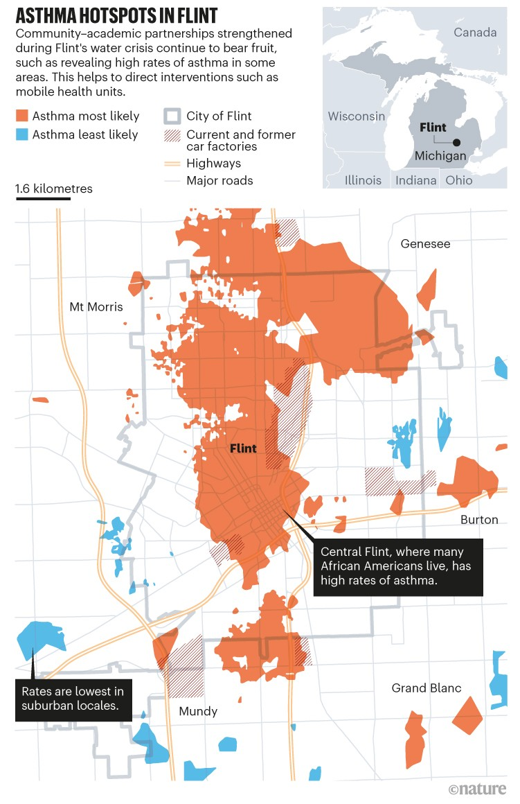
Community – academic partnerships helped Flint through its water crisis
The Crisis:
Flint and its water problems
Since 2014 state government diverted public water through aging pipes containing lead.
High levels of poisoning in 2016 leaving many sick and dead
A US$640 million class-action lawsuit in the courts. 9 officials charged
The Heroes:
Residents and researchers.
Community members needed the voice of the scientists to make their case.
Community health testing
Partnering with non-profits like the Genesee Health plan
Increase community awareness and open up centers for furthering research
Lewis, E. Y.; Sadler, R. C. Nature 2021, 594, 326–329

Slide 26
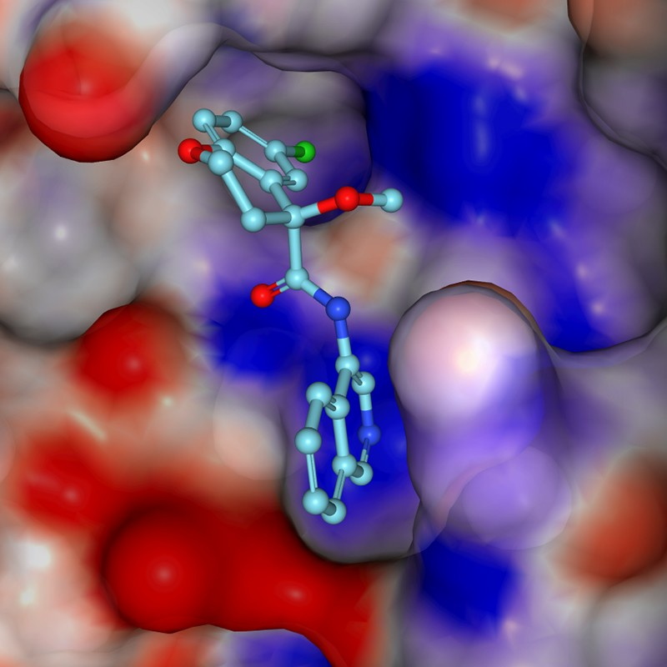
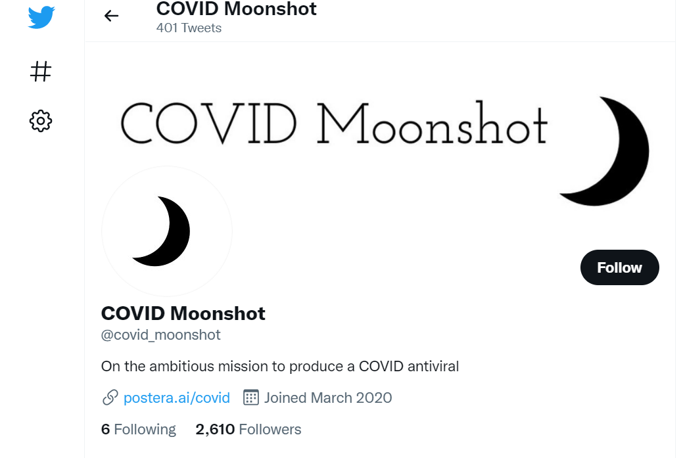
A white-knuckle ride of open COVID discovery
Proving conventional wisdom wrong that de novo drug discovery is the job of big pharma
Twitter fueled collaboration
More than 150 active participants from biotech, academia, pharma
No intellectual property constraints
Crystal structure of a COVID Moonshot advanced compound (turquoise) in the active site of the SARS-CoV-2 main protease. The molecular surface colors show electrostatic charge.
Credit: fragalysis.diamond.ac.uk
von Delft, F. et al. Nature 2021, 594, 330–332
Notes:
Twitter

Slide 27

COVID pushed global research to come together

Slide 28
Academia-Industry Collaboration

Slide 29
When should we collaborate?
Industry-Academia
Process and technology transfer
Knowledge & Innovation
Job/ Economic Diversity
Intellectual property
Industry concerns for initiating collaboration:
Stage (usually drug discovery)
Nature (partnership vs transactional including in- and out-licensing)
Scope (role of involved parties and their functions)
Market value of opportunity
New technology integration
Academia concerns for collaboration:
Throughput efficiency and gain
Access to vast resource and streamlined workflow
Knowledge outsource
Rights for publication
https://cheekyscientist.com/academia-industry-partnerships-create-jobs-for-phds/

Slide 30
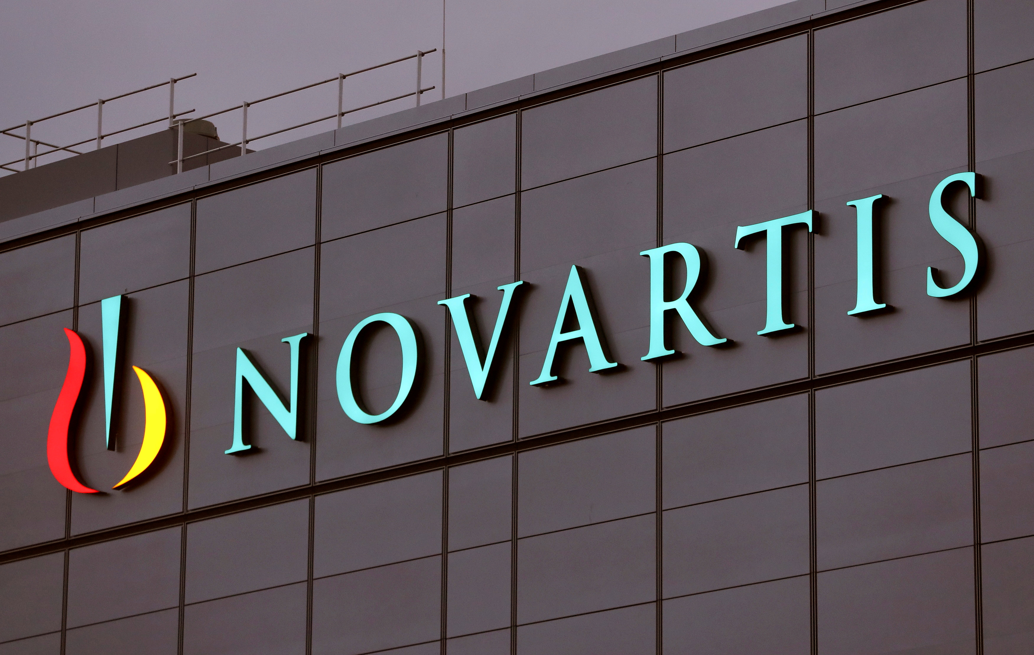
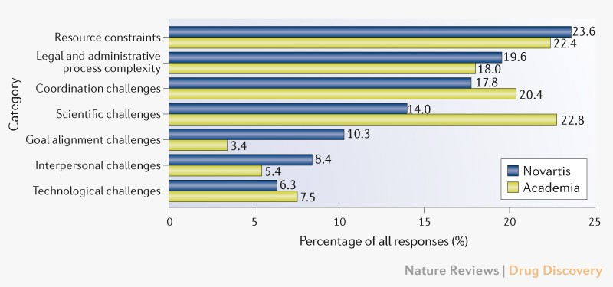
Demystifying industry–academia collaboration
137 collaborative projects in Novartis (non-transactional excluding)
669 participants (416 from Novartis and 253 from the academic partners)
Relative importance of different challenges in industry–academia collaborations by organization.
Resources (human & instrument)
Legal
Communication
Gersdorf, T.; He, V. F. et al. Nat. Rev. Drug Discovery 2019, 18, 743–744
Notes:
Paper gives a nice fact-based analytical review of the aspects of industry-academia challenges

Slide 31
Demystifying industry–academia collaboration
137 collaborative projects in Novartis (non-transactional excluding)
669 participants (416 from Novartis and 253 from the academic partners)
Concrete suggestions
Timeline management
Go No-go decisions
Regular updates/ joint working groups
Resource Management
Project management
Legal matters: Collaborative agreements.
Hurdle at the onset but work better once the project is running
Relative importance of different challenges in industry–academia collaborations by organization.
Resources (human & instrument)
Legal
Communication
Is this surprising?
Gersdorf, T.; He, V. F. et al. Nat. Rev. Drug Discovery 2019, 18, 743–744
Notes:
Paper gives a nice fact-based analytical review of the aspects of industry-academia challenges

Slide 32
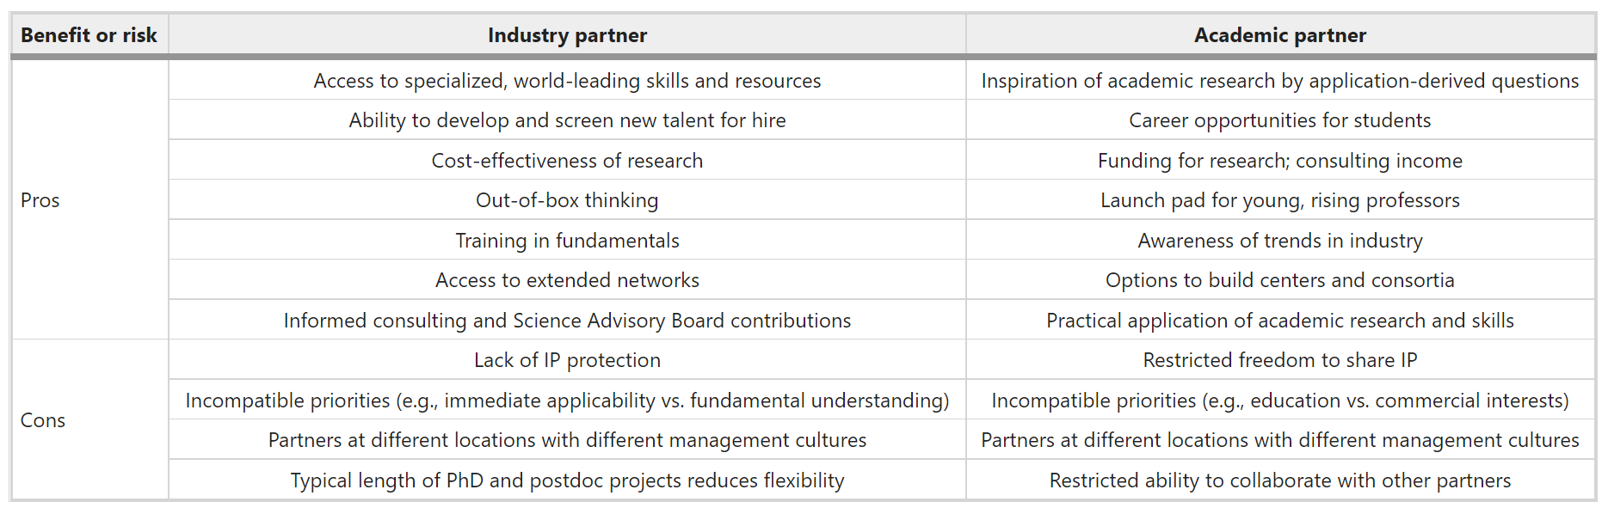









How to set up collaborations between academia and industrial biotech companies
Pronk, J.; Lee, S.; Lievense, J. et al. Nat. Biotechnol. 2015, 33, 237–240

Slide 33
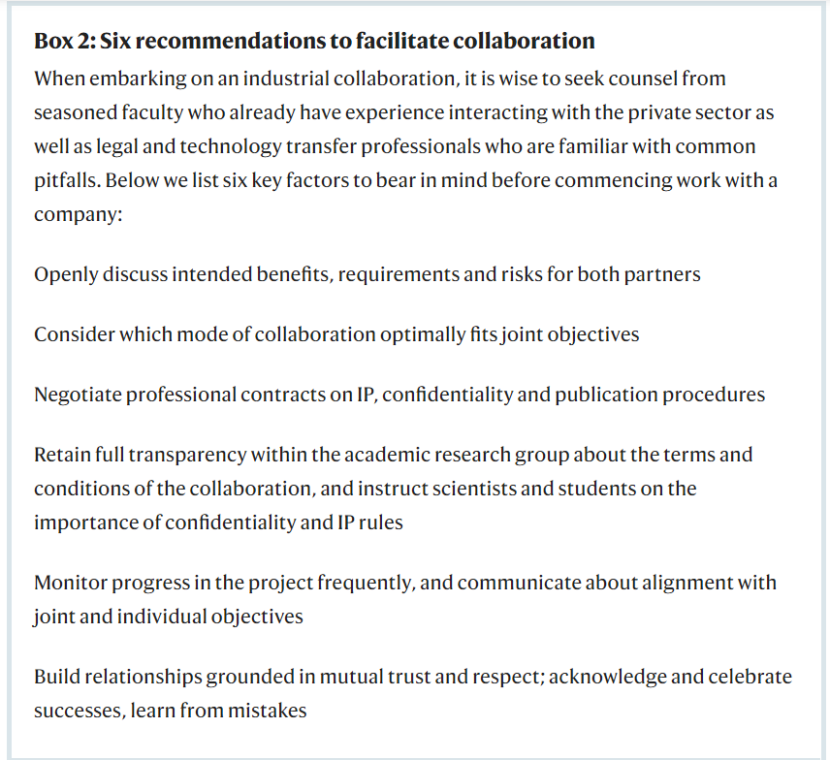







Modes of Collaboration
Consultancy (easy first step that can lead to other types)
Contract research (well defined and usually financially beneficial to both)
PPP/Research consortium type (long-term and most beneficial to all parties and society)
Pronk, J.; Lee, S.; Lievense, J. et al. Nat. Biotechnol. 2015, 33, 237–240

Slide 34
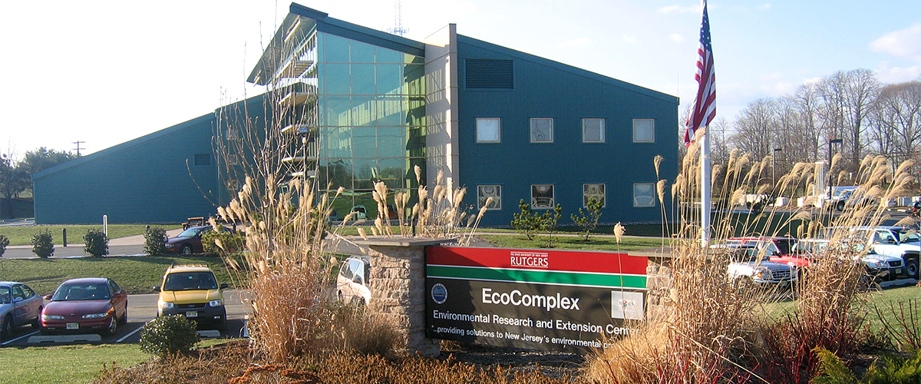
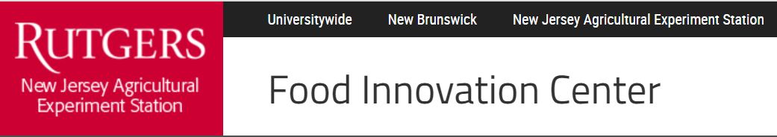
The symbiotic relationship between academia and industry allowed to create business incubation and acceleration centers in academic institutions
“The Food Innovation Center at Rutgers University is a unique food business incubator and accelerator that is a unit of the Rutgers New Jersey Agricultural Experiment Station (NJAES). The Center supports established early stage entrepreneurs and existing food companies from concept to commercialization. Combining years of industry expertise and the advanced technologies offered by Rutgers, we provide business, marketing, food safety, product design and scale up expertise within FDA and USDA certified facilities to help companies successfully build and grow their business”
Rutgers’ EcoComplex – “The EcoComplex "Clean Energy Innovation Center" is the state's clean technology and environmental research, outreach and business incubation center. It serves as a university-based hub of information and resources for industry, academia and government. The resources at the EcoComplex are designed to facilitate the commercialization of new technologies and business concepts. We believe, supporting development of clean energy, environmental and controlled environment agriculture related innovations will contribute to economic growth and overall sustainability of New Jersey”

Slide 35

Thank you for your attention!
Any Questions?

